Slide 1
Overlooked Gems
Rob Pesale
IT Manager
Clayton Nummer
IT Specialist
Jeff Crocker
Main Library Branch Manager
West Bloomfield Township Public Library

Slide 2
Book Subscription Service

Slide 3
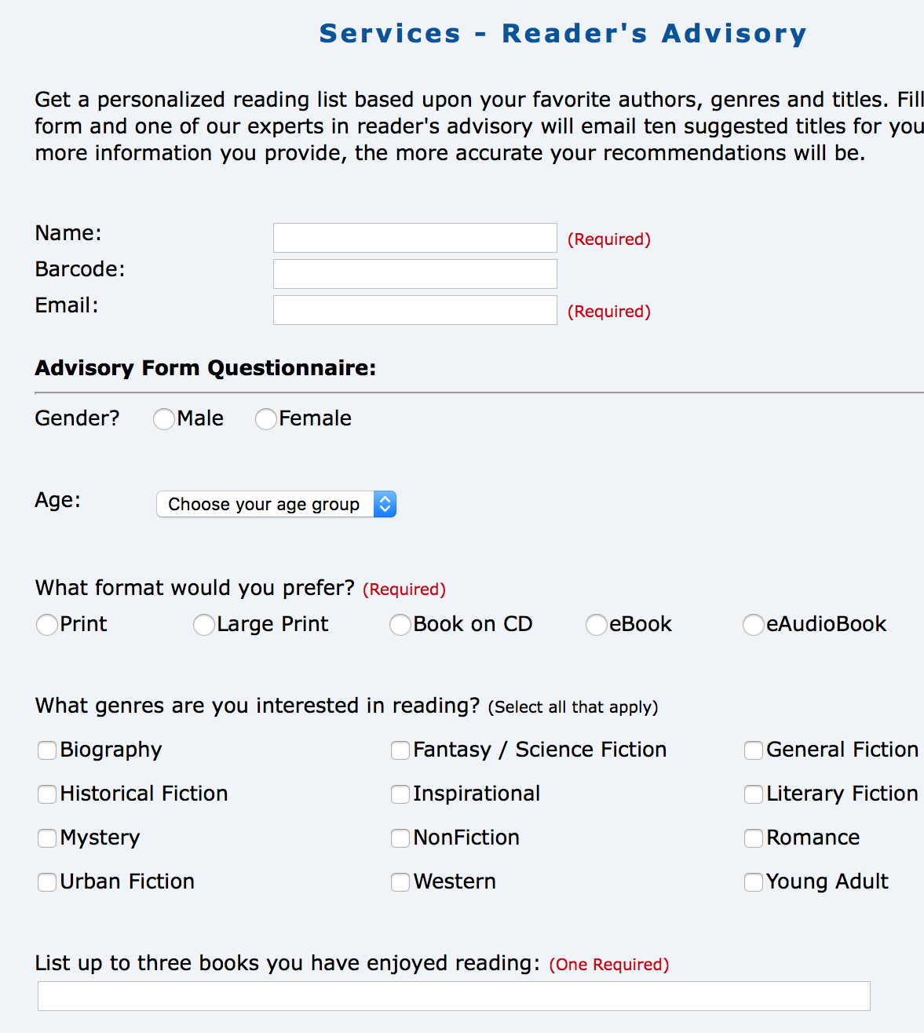
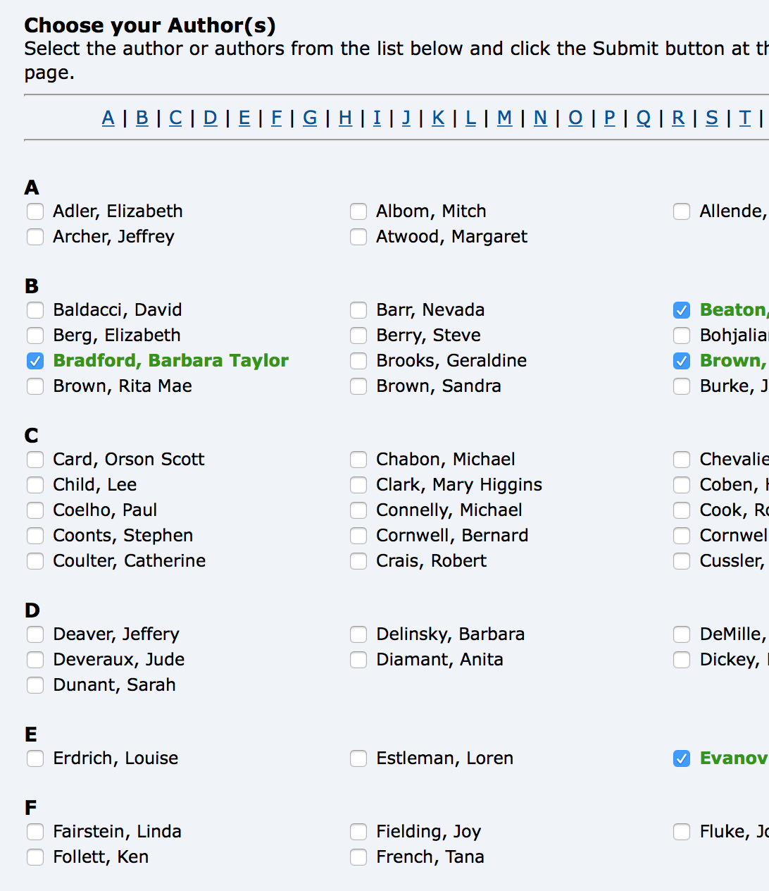
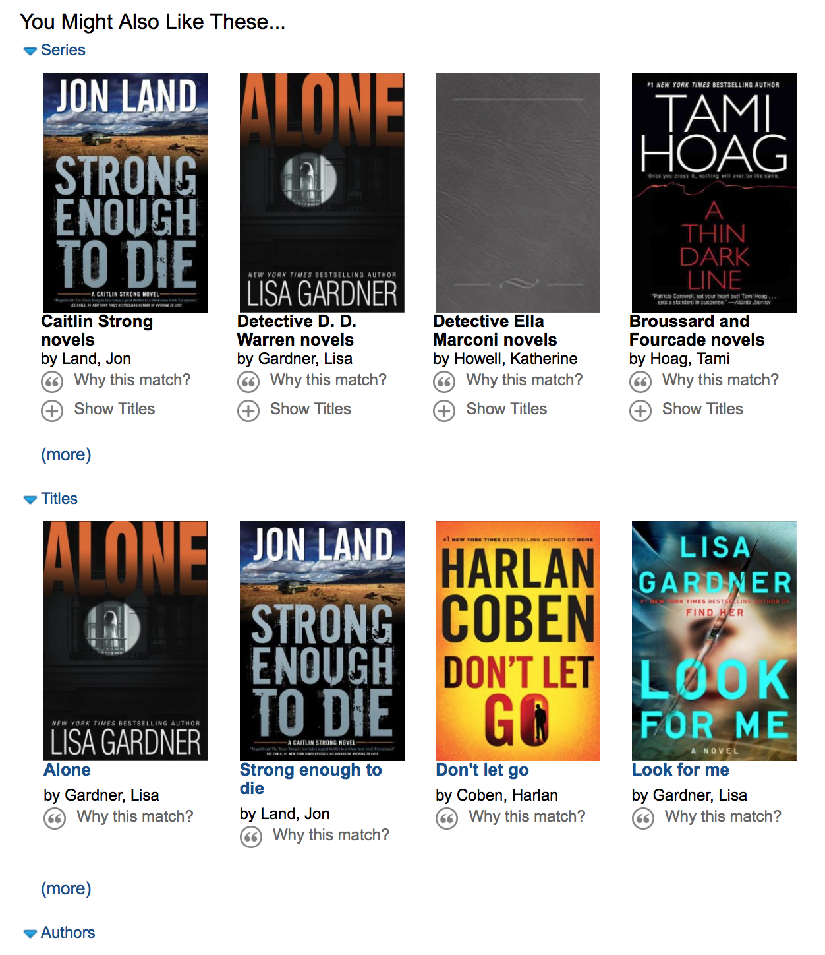
Problems Solved
Reader’s Advisory Service
Best Sellers Club
NoveList Select in Encore
Notes:
Want to provide more reader’s advisory without too much staff or patron intervention. Our patrons can get automatic holds and readers advisory already but not from the same service.
Currently have a reader’s advisory form on our website that librarians respond to
But patrons have to fill it out and wait for a librarian to respond. Then they have to place their hold or ask a librarian do it for them
We have a best sellers club where patrons select their favorite authors and we automatically place holds on their newest titles
But they’re limited to only the authors included in the club and they must login and select authors. Also, they don’t know when their next book is coming
My favorite product is Novelist Select in Encore which makes recommendations based on title being viewed and then patrons can place holds on titles they’re interested in
But they have to search Encore, select a title to view, and scroll to the bottom of the page

Slide 4

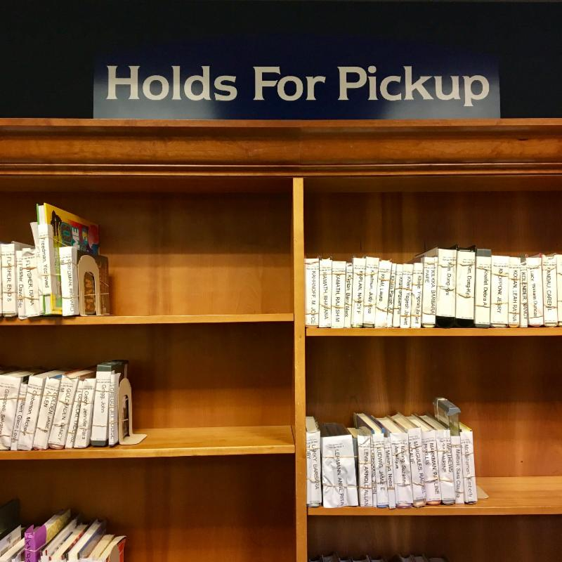


Problems Solved
Next generation reader’s advisory
Subscription style service
Data driven recommendations
Automatic holds
Notes:
We feel that the next logical step in reader’s advisory, is for us to offer a subscription style service
We will let patrons choose how frequently they would like a book selected and held for them at their preferred pickup location
We will automatically place holds on titles that they’d be interested in
And we’ll do this by utilizing their reading history and their feedback on titles in their history

Slide 5
Tech Used
HTML
PHP
SierraDNA
Sierra API
Zola API
Notes:
We used DNA to gather patron information/history
We used the Zola API to provide recommendations
We used the Sierra API to place the holds

Slide 6
Demo
www.wblib.org/Overlooked-Gems/2018
Last Name: Gems Barcode: 222222

Slide 7
Implement
Integrate with existing Bestseller’s Club
Add ratings to courtesy notices
Update reading histories
Allow sorting by oldest checkout date
Notes:
Integrate this product with our existing Bestseller’s Club
Add the ability to thumbs up or thumbs down titles in courtesy notices to build our knowledge bank and to draw new users into the system
Create a utility to delete patrons who turn off their reading history in Sierra

Slide 8
Enhance
Evaluate other APIs
Movie recommendations
Notes:
Evaluate other APIs that provide recommendations
NoveList
Amazon
Add movie recommendations since DVD checkouts are still a big part of our circulation

Slide 9
Code
https://github.com/claytonjn/Overlooked-Gems/tree/2018

Slide 10
Contacts
Rob Pesale
pesalero@wblib.org
Clayton Nummer
nummercl@wblib.org
Jeff Crocker
crockerj@wblib.org

